Slide 1

Introduction to Neural Networks
Why is Deep Learning taking off?
deeplearning.ai

Slide 2
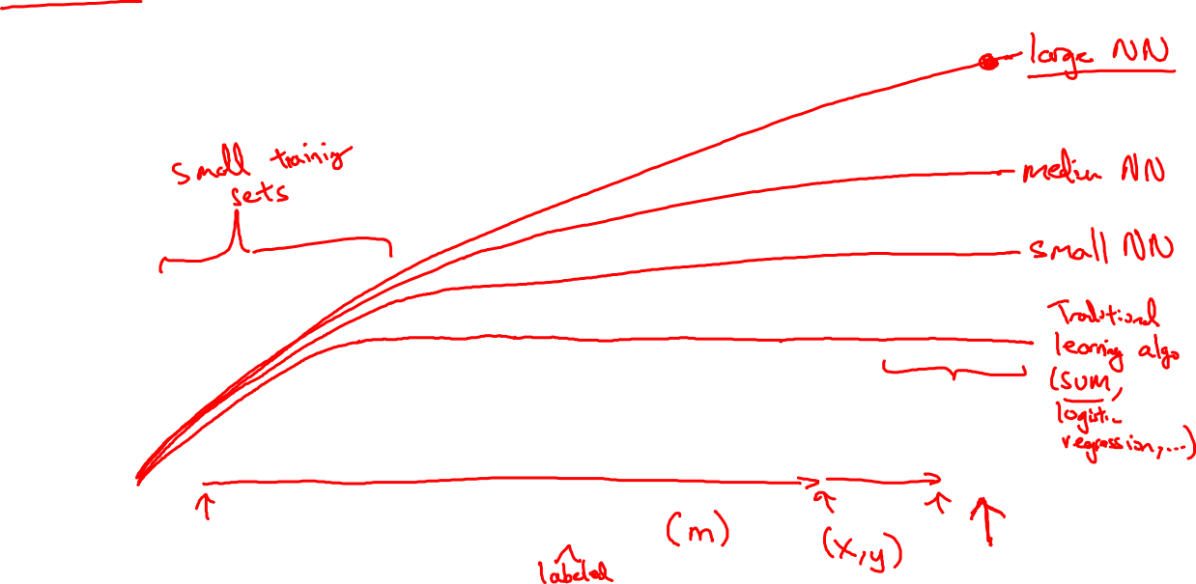
Scale drives deep learning progress
Performance
Amount of data

Slide 3

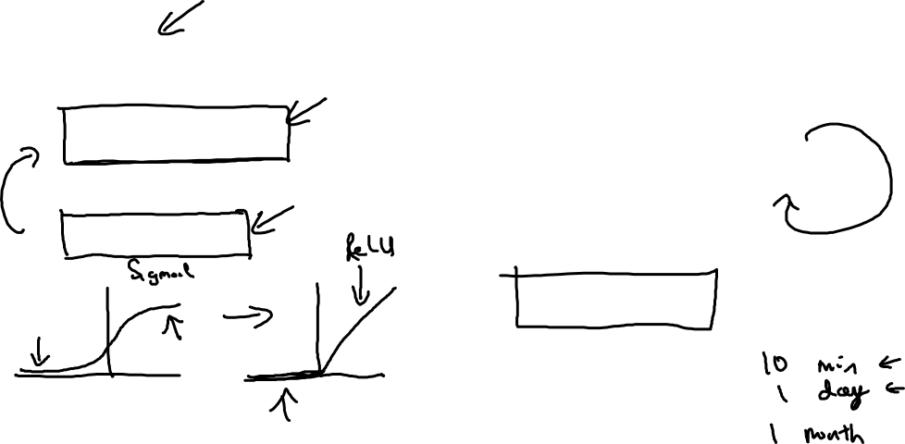
Scale drives deep learning progress
Idea
Data
Computation
Algorithms
Experiment
Code

